Slide 1
WEEK 2
Project

Slide 2
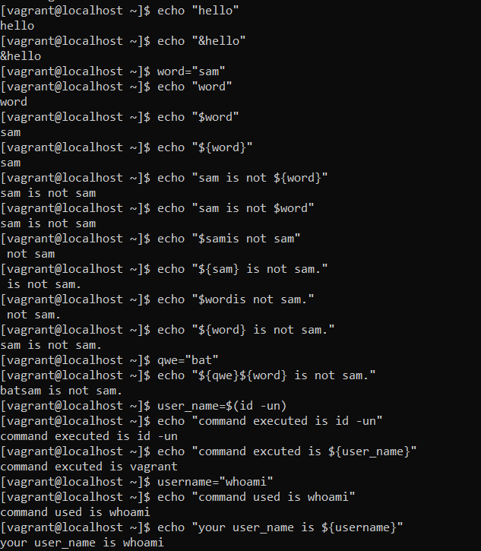
echo “hello”
hello
echo “$word”
$word
word = “sam”
echo “$word”
sam
echo “${word}”
sam
echo “sam is not ${word}”
sam is not sam
echo “sam is not $word”
sam is not sam
username = $(id –un)
echo “command excuted is id –un”
commmand excuted is id -un
echo “your username is ${username}”
your username is vagrant
username = “whoami”
echo “command used is whoami”
command used is whoami
echo “command used is ${username}”
command used is whoami

Slide 3
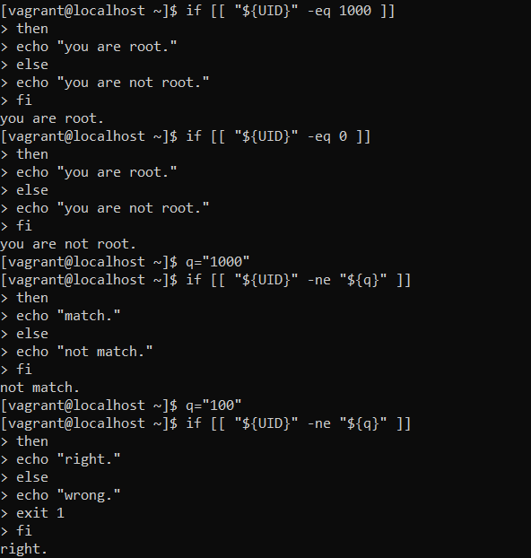
if [[ “${UID}” –eq 1000 ]]
then
echo “you are root.”
else
echo “you are not root.”
fi
you are root.
if [[ “${UID}” –eq 10 ]]
then
echo “you are root.”
else
echo “you are not root.”
fi
you are not root.

Slide 4
username = $(id –un)
q=“vagrant”
if [[ ‘’${username}” -eq “${q}” ]]
then
echo “Your username matches ${q}.”
exit 1
fi
Your username matches vagrant.

Slide 5
read –p “enter the username to create ” username
Enter the username to create samarth123
Read –p “enter the name of the person who this account is for:” comment
Enter the name of the person who this account is for: samarth
Read –p “enter the password to use for the account:” password
Enter the password to use for the account:Qwertyuiop
Echo ${password} | passwd –stdin ${username}
Only root can do that.
Passwd –e ${username}
Only root can do that.

Slide 6
